Slide 2
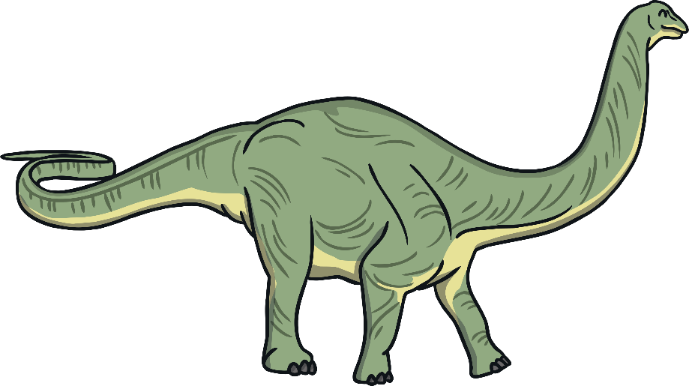
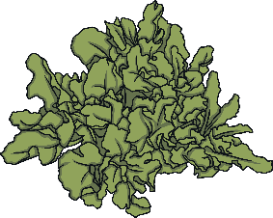
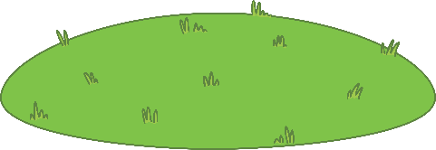
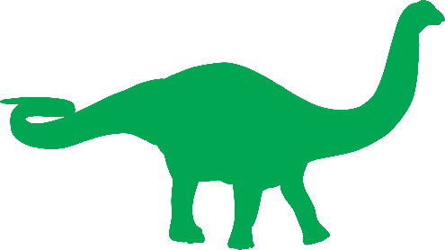
Apatosaurus
Diet:
Click to hear the correct pronunciation.
plants
Fascinating Fact:
Apatosaurus’ had long whip-like tails that helped balance their long necks.
Height: 5m
Length: 21m
Weight: 16,000kg

Slide 3
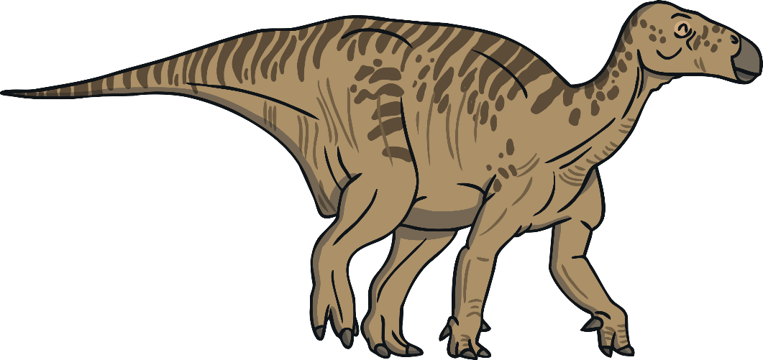
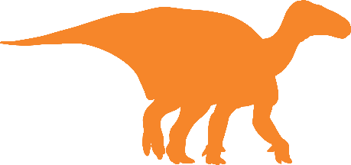
Iguanodon
Click to hear the correct pronunciation.
Diet:
plants
Fascinating Fact:
This dinosaur could walk on two legs or on all four legs.
Height: 3m
Length: 10m
Weight: 4,000kg

Slide 4
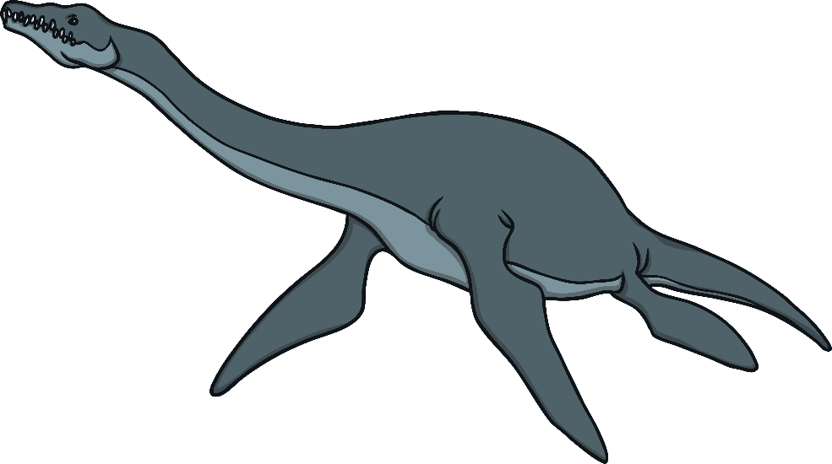
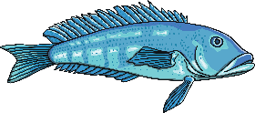
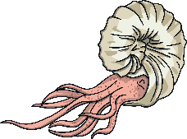
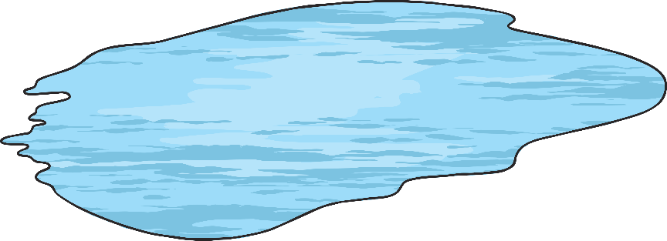
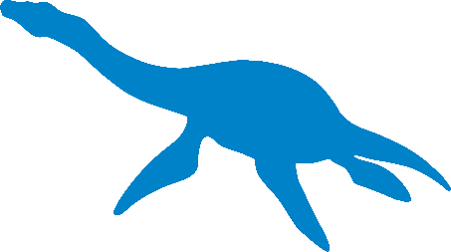
Plesiosaur
Click to hear the correct pronunciation.
Diet:
fish
molluscs
Fascinating Fact:
They lived in shallow waters near the coast.
Height: 1m
Length: 4.5m
Weight: 450kg

Slide 5
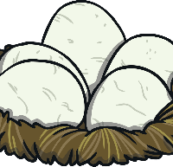
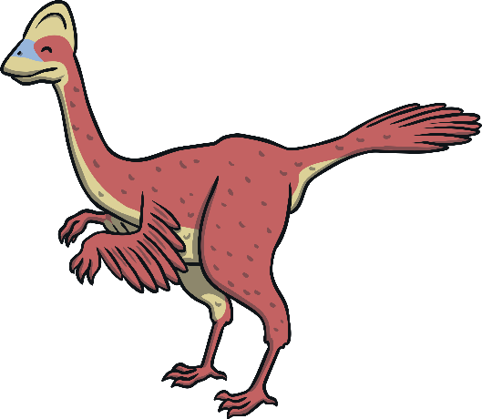
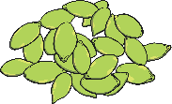
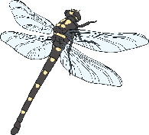
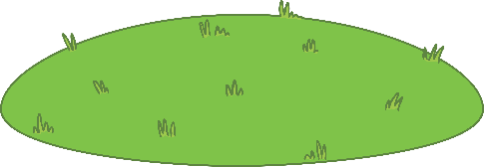
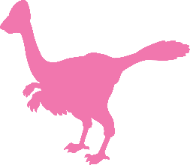
Oviraptor
Diet:
Click to hear the correct pronunciation.
meat
eggs
seeds
insects
plants
Height: 2m
Fascinating Fact:
This dinosaur had feathers and a powerful jaw.
Length: 1.5m
Weight: 20kg

Slide 6
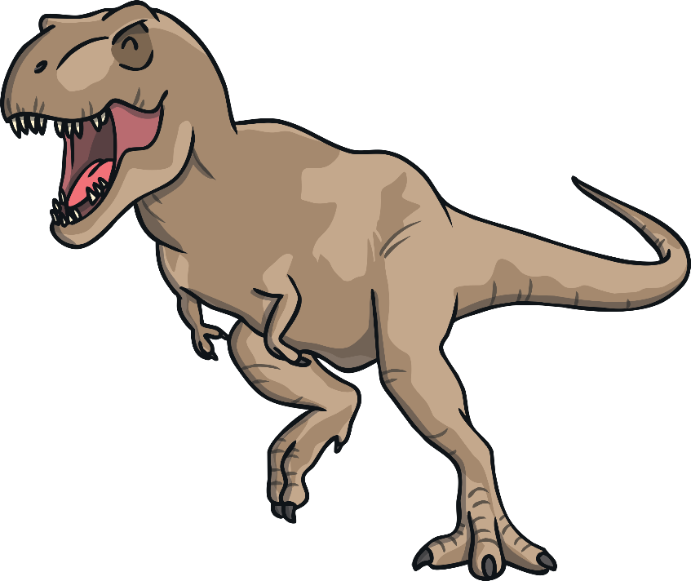
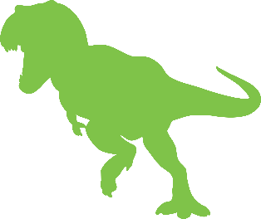
Tyrannosaurus
Click to hear the correct pronunciation.
Diet:
other dinosaurs such as triceratops
Fascinating Fact:
This fearsome dinosaur could crush the bones of other dinosaurs.
Height: 12m
Length: 6m
Weight: 7,000kg

Slide 7
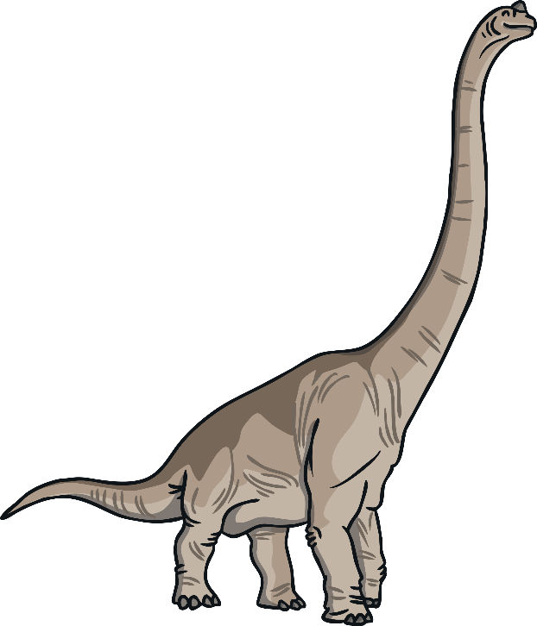
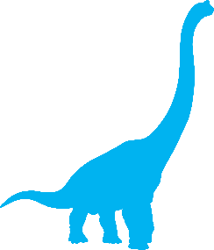
Brachiosaurus
Click to hear the correct pronunciation.
Diet:
plants
Fascinating Fact:
This dinosaur is the largest and heaviest land animal ever discovered.
Height: 26m
Length: 16m
Weight: 80,000kg

Slide 8
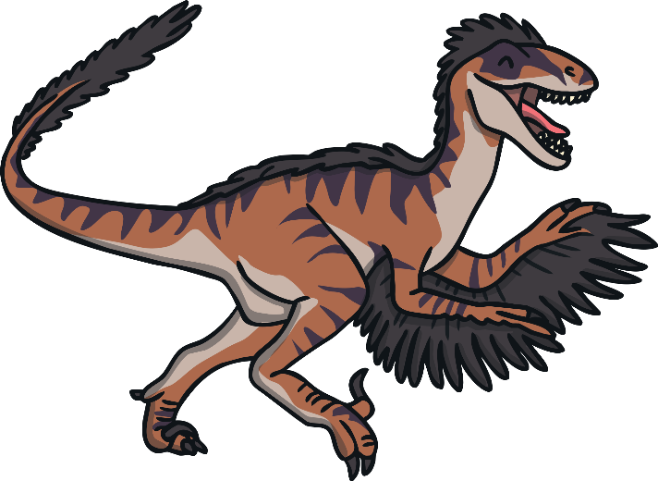
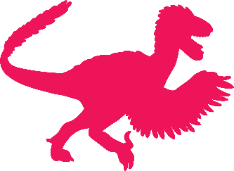
Velociraptor
Click to hear the correct pronunciation.
Diet:
Leftover carcasses killed by larger dinosaurs
Fascinating Fact:
Velociraptor’s bodies were about the same size as a Christmas turkey.
Height: 2m
Length: 0.5m
Weight: 15kg

Slide 9
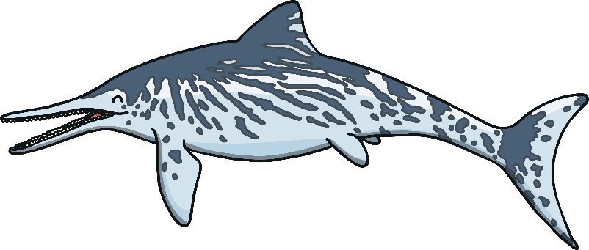
Ichthyosaur
Diet:
Click to hear the correct pronunciation.
fish
molluscs
squid
Fascinating Fact:
Height: 1m
Ichthyosaurs had huge, flat eye, up to 25cm across
Length: 15m
Weight: 100kg

Slide 10
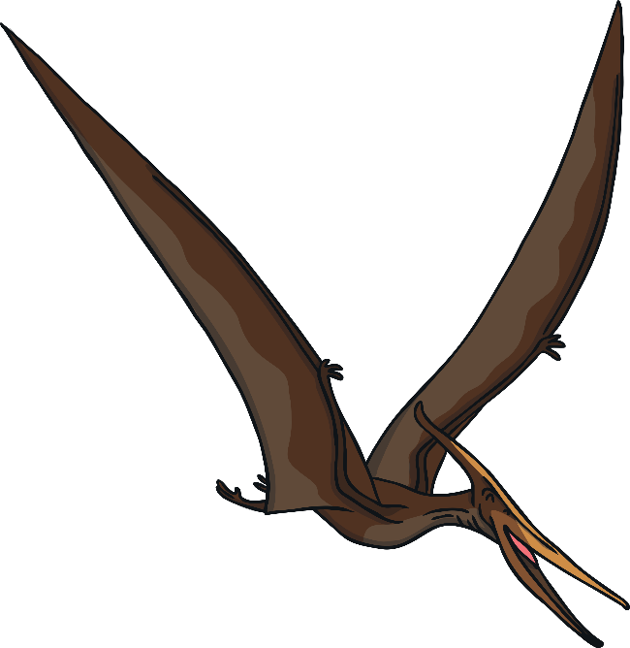
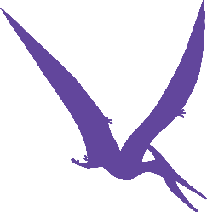
Pterodactyl
Diet:
Click to hear the correct pronunciation.
fish
insects
Leftover carcasses killed by larger dinosaurs
Fascinating Fact:
Height: 3m
The Pterodactyl was able to fly long distances with its lightweight wings.
Length: 6m
Weight: 12kg

Slide 11
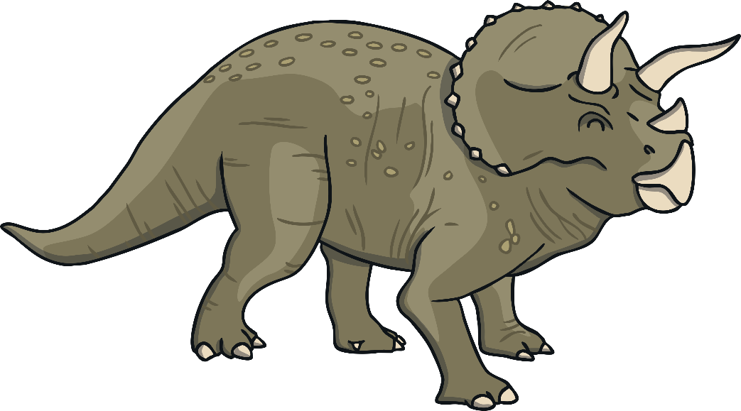
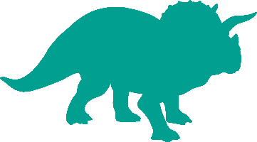
Triceratops
Click to hear the correct pronunciation.
Diet:
plants
Fascinating Fact:
Triceratops had three nose horns they used for defence.
Height: 3m
Length: 9m
Weight: 12,000kg

Slide 12
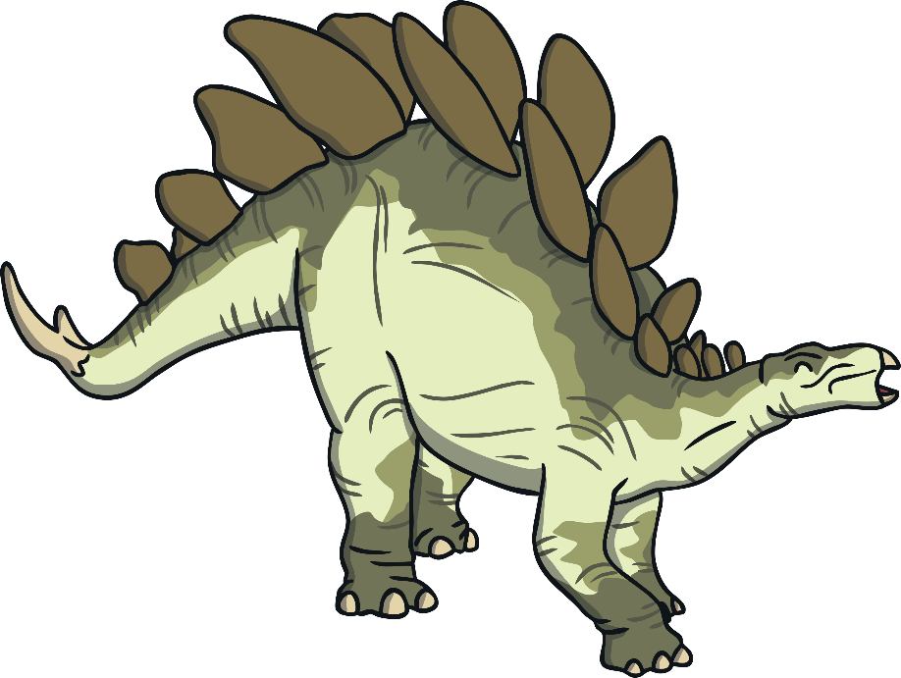
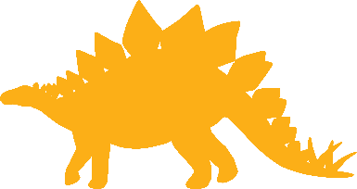
Stegosaurus
Diet:
Click to hear the correct pronunciation.
plants
Fascinating Fact:
Although the Stegosaurus’ body was large the size of their brain was only around the size of a dog’s.
Height: 3m
Length: 9m
Weight: 3,000kg

